Slide 1
CS 5683: Algorithms & Methods for Big Data Analytics Dimensionality Reduction – SVD and CUR
Arunkumar Bagavathi
Department of Computer Science
Oklahoma State university

Slide 2
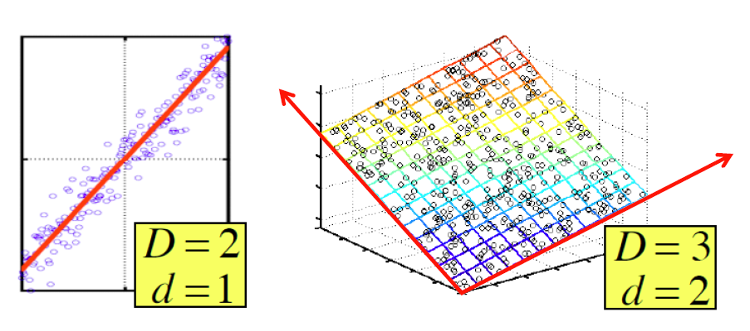
Dimensionality Reduction
Assumption: Data lies on or near a low d-dimensional subspace
Axes of this subspace are effective representation of the data

Slide 3
Singular Value Decomposition
A_{[m x n]} = U_{[m x r]} Σ _{[ r x r]} (V_{[n x r]})^{T}
A: Input data matrix
m x n matrix (e.g., m documents, n terms)
U: Left singular vectors
m x r matrix (m documents, r concepts)
Σ: Singular values
r x r diagonal matrix (strength of each ‘concept’) (r : rank of the matrix A)
V: Right singular vectors
n x r matrix (n terms, r concepts)

Slide 4
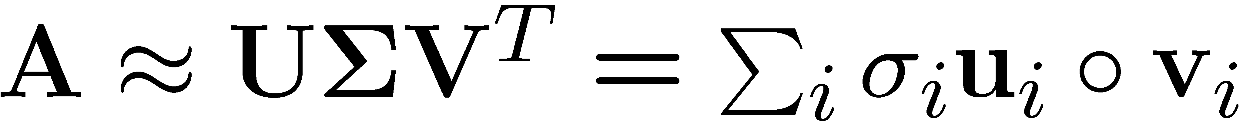
SVD
n
n
A
≈
Σ
V^{T}
m
m

Slide 5
SVD
σ₁u₁v₁
σ₂u₂v₂
A
≈
+
σ_{i} … scalar
u_{i} … vector
v_{i} … vector

Slide 6
SVD - Properties
It is always possible to decompose a real matrix A into A = U Σ V^{T} , where
U, Σ, V: unique
U, V: column orthonormal
U^{T} U = I; V^{T} V = I (I: identity matrix)
(Columns are orthogonal unit vectors)
Σ: diagonal
Entries (singular values) are positive, and sorted in decreasing order (σ₁ ≥ σ₂ ≥ ... ≥ 0)

Slide 7
SVD – Example: Users-to-Movies
Matrix
Alien
Serenity
Casablanca
Amelie
A = U Σ V^{T} - example: Users to Movies
n
1 1 1 0 0
3 3 3 0 0
4 4 4 0 0
5 5 5 0 0
0 2 0 4 4
0 0 0 5 5
0 1 0 2 2
SciFi
Σ
V^{T}
=
m
Romance
U
“Concepts” AKA Latent dimensions AKA Latent factors

Slide 8
SVD – Example: Users-to-Movies
Matrix
Alien
Serenity
Casablanca
Amelie
A = U Σ V^{T} - example: Users to Movies
1 1 1 0 0
3 3 3 0 0
4 4 4 0 0
5 5 5 0 0
0 2 0 4 4
0 0 0 5 5
0 1 0 2 2
0.13 0.02 -0.01
0.41 0.07 -0.03
0.55 0.09 -0.04
0.68 0.11 -0.05
0.15 -0.59 0.65
0.07 -0.73 -0.67
0.07 -0.29 0.32
SciFi
12.4 0 0
0 9.5 0
0 0 1.3
=
x
x
Romnce
0.56 0.59 0.56 0.09 0.09
0.12 -0.02 0.12 -0.69 -0.69
0.40 -0.80 0.40 0.09 0.09

Slide 9
SVD – Example: Users-to-Movies
Matrix
Alien
Serenity
Casablanca
Amelie
A = U Σ V^{T} - example: Users to Movies
U is “user-to-concept” matrix
SciFi-concept
Romance-concept
1 1 1 0 0
3 3 3 0 0
4 4 4 0 0
5 5 5 0 0
0 2 0 4 4
0 0 0 5 5
0 1 0 2 2
0.13 0.02 -0.01
0.41 0.07 -0.03
0.55 0.09 -0.04
0.68 0.11 -0.05
0.15 -0.59 0.65
0.07 -0.73 -0.67
0.07 -0.29 0.32
SciFi
12.4 0 0
0 9.5 0
0 0 1.3
=
x
x
Romnce
0.56 0.59 0.56 0.09 0.09
0.12 -0.02 0.12 -0.69 -0.69
0.40 -0.80 0.40 0.09 0.09

Slide 10
SVD – Example: Users-to-Movies
Matrix
Alien
Serenity
Casablanca
Amelie
A = U Σ V^{T} - example: Users to Movies
SciFi-concept
“strength” of the SciFi-concept
1 1 1 0 0
3 3 3 0 0
4 4 4 0 0
5 5 5 0 0
0 2 0 4 4
0 0 0 5 5
0 1 0 2 2
0.13 0.02 -0.01
0.41 0.07 -0.03
0.55 0.09 -0.04
0.68 0.11 -0.05
0.15 -0.59 0.65
0.07 -0.73 -0.67
0.07 -0.29 0.32
SciFi
12.4 0 0
0 9.5 0
0 0 1.3
=
x
x
Romnce
0.56 0.59 0.56 0.09 0.09
0.12 -0.02 0.12 -0.69 -0.69
0.40 -0.80 0.40 0.09 0.09

Slide 11
SVD – Example: Users-to-Movies
Matrix
Alien
Serenity
Casablanca
Amelie
A = U Σ V^{T} - example: Users to Movies
V is “movie-to-concept”
similarity matrix
SciFi-concept
1 1 1 0 0
3 3 3 0 0
4 4 4 0 0
5 5 5 0 0
0 2 0 4 4
0 0 0 5 5
0 1 0 2 2
0.13 0.02 -0.01
0.41 0.07 -0.03
0.55 0.09 -0.04
0.68 0.11 -0.05
0.15 -0.59 0.65
0.07 -0.73 -0.67
0.07 -0.29 0.32
SciFi
12.4 0 0
0 9.5 0
0 0 1.3
=
x
x
Romnce
0.56 0.59 0.56 0.09 0.09
0.12 -0.02 0.12 -0.69 -0.69
0.40 -0.80 0.40 0.09 0.09
SciFi-concept

Slide 12
SVD – Interpretation #1
‘movies’, ‘users’ and ‘concepts’:
U: user-to-concept similarity matrix
V: movie-to-concept similarity matrix
Σ: its diagonal elements: ‘strength’ of each concept

Slide 13
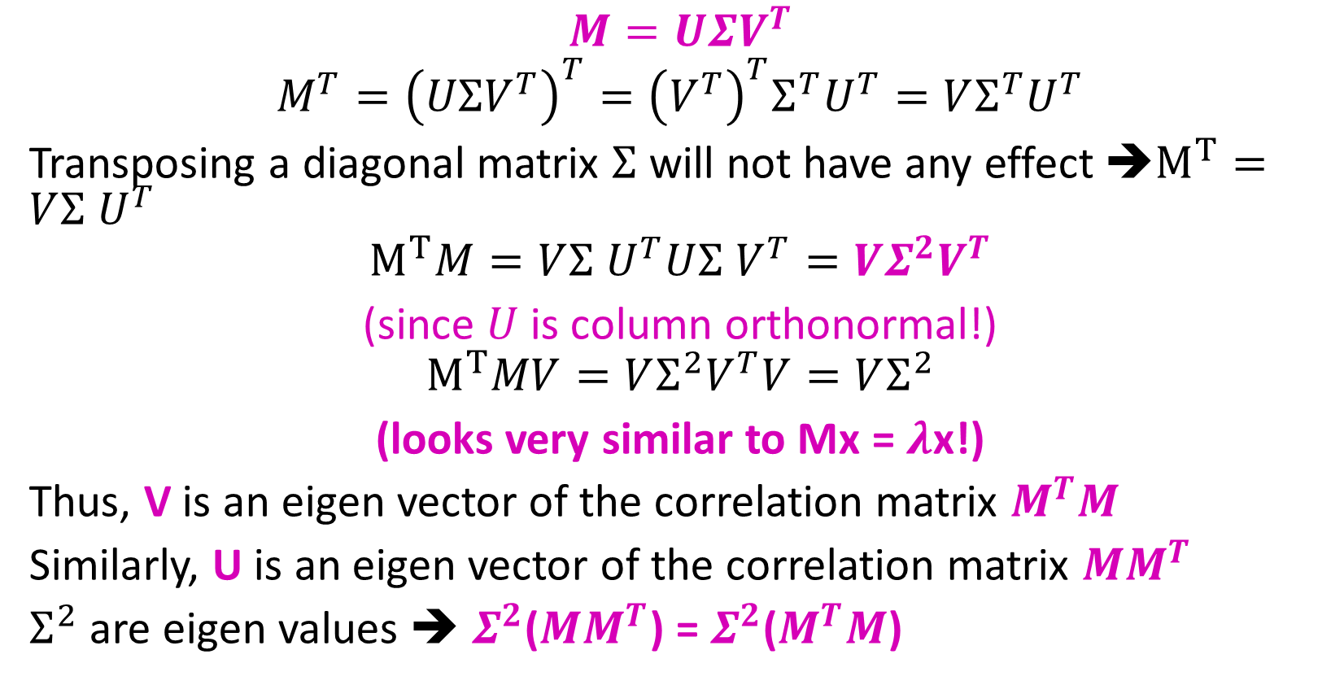
Solving SVD
$$M=UΣV^{T}$$
$$M^{T}={\left(UΣV^{T}\right)}^{T}={\left(V^{T}\right)}^{T}Σ^{T}U^{T}=VΣ^{T}U^{T}$$
Transposing a diagonal matrix $Σ^{ }$will not have any effect ➔$M^{T}=VΣ^{ }U^{T}$
$$M^{T}M=VΣ^{ }U^{T}UΣ^{ }V^{T}=VΣ^{2}V^{T}$$
(since $U$ is column orthonormal!)
$$M^{T}MV=VΣ^{2}V^{T}V=VΣ^{2}$$
(looks very similar to Mx = $λ$x!)
Thus, V is an eigen vector of the correlation matrix $M^{T}M$
Similarly, U is an eigen vector of the correlation matrix ${MM}^{T}$
$Σ^{2}$ are eigen values ➔ $Σ^{2}$(${MM}^{T}$) = $Σ^{2}$($M^{T}M$)

Slide 14
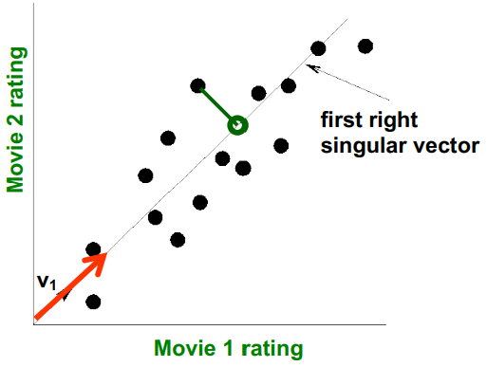
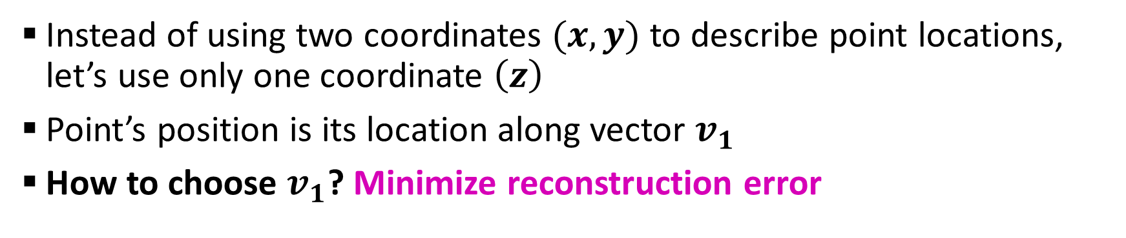
SVD – Dimensionality Reduction
Instead of using two coordinates $(x,y)$ to describe point locations, let’s use only one coordinate $\left(z\right)$
Point’s position is its location along vector $v_{1}$
How to choose $v_{1}$? Minimize reconstruction error

Slide 15
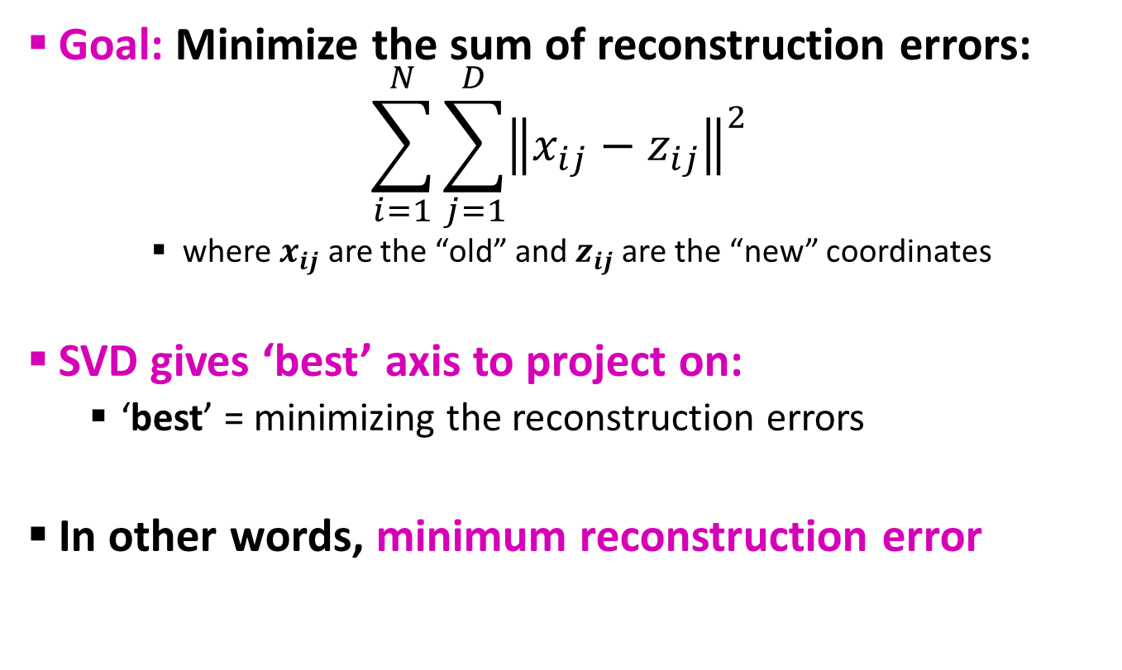
SVD – Dimensionality Reduction
Goal: Minimize the sum of reconstruction errors:
$$\sum_{i=1}^{N}{\sum_{j=1}^{D}{{\left\|x_{ij}−z_{ij}\right\|}^{2}}}$$
where $x_{ij}$ are the “old” and $z_{ij}$ are the “new” coordinates
SVD gives ‘best’ axis to project on:
‘best’ = minimizing the reconstruction errors
In other words, minimum reconstruction error

Slide 16
SVD – Dimensionality Reduction
A = U Σ V^{T} - example:
V: “movie-to-concept” matrix
U: “user-to-concept” matrix
variance (‘spread’) on the v₁ axis
1 1 1 0 0
3 3 3 0 0
4 4 4 0 0
5 5 5 0 0
0 2 0 4 4
0 0 0 5 5
0 1 0 2 2
0.13 0.02 -0.01
0.41 0.07 -0.03
0.55 0.09 -0.04
0.68 0.11 -0.05
0.15 -0.59 0.65
0.07 -0.73 -0.67
0.07 -0.29 0.32
12.4 0 0
0 9.5 0
0 0 1.3
=
x
x
0.56 0.59 0.56 0.09 0.09
0.12 -0.02 0.12 -0.69 -0.69
0.40 -0.80 0.40 0.09 0.09

Slide 17
SVD – Dimensionality Reduction
A = U Σ V^{T} - example:
U Σ: Gives the coordinates of the points in the projection axis
1 1 1 0 0
3 3 3 0 0
4 4 4 0 0
5 5 5 0 0
0 2 0 4 4
0 0 0 5 5
0 1 0 2 2
Projection of users on the “Sci-Fi” axis (U Σ) ^{Τ}:
1.61 0.19 -0.01
5.08 0.66 -0.03
6.82 0.85 -0.05
8.43 1.04 -0.06
1.86 -5.60 0.84
0.86 -6.93 -0.87
0.86 -2.75 0.41

Slide 18
SVD – Dimensionality Reduction
More details
Q: How exactly is dim. Reduction done?
A: Set smaller singular values to zero
1 1 1 0 0
3 3 3 0 0
4 4 4 0 0
5 5 5 0 0
0 2 0 4 4
0 0 0 5 5
0 1 0 2 2
0.13 0.02 -0.01
0.41 0.07 -0.03
0.55 0.09 -0.04
0.68 0.11 -0.05
0.15 -0.59 0.65
0.07 -0.73 -0.67
0.07 -0.29 0.32
12.4 0 0
0 9.5 0
0 0 1.3
=
x
x
0.56 0.59 0.56 0.09 0.09
0.12 -0.02 0.12 -0.69 -0.69
0.40 -0.80 0.40 0.09 0.09

Slide 19
SVD – Dimensionality Reduction
More details
Q: How exactly is dim. Reduction done?
A: Set smaller singular values to zero
1 1 1 0 0
3 3 3 0 0
4 4 4 0 0
5 5 5 0 0
0 2 0 4 4
0 0 0 5 5
0 1 0 2 2
0.13 0.02 -0.01
0.41 0.07 -0.03
0.55 0.09 -0.04
0.68 0.11 -0.05
0.15 -0.59 0.65
0.07 -0.73 -0.67
0.07 -0.29 0.32
12.4 0 0
0 9.5 0
0 0 1.3
≈
x
x
0.56 0.59 0.56 0.09 0.09
0.12 -0.02 0.12 -0.69 -0.69
0.40 -0.80 0.40 0.09 0.09

Slide 20
SVD – Dimensionality Reduction
More details
Q: How exactly is dim. Reduction done?
A: Set smaller singular values to zero
1 1 1 0 0
3 3 3 0 0
4 4 4 0 0
5 5 5 0 0
0 2 0 4 4
0 0 0 5 5
0 1 0 2 2
0.13 0.02
0.41 0.07
0.55 0.09
0.68 0.11
0.15 -0.59
0.07 -0.73
0.07 -0.29
12.4 0
0 9.5
≈
x
x
0.56 0.59 0.56 0.09 0.09
0.12 -0.02 0.12 -0.69 -0.69

Slide 21
SVD – Dimensionality Reduction
More details
Q: How exactly is dim. Reduction done?
A: Set smaller singular values to zero
1 1 1 0 0
3 3 3 0 0
4 4 4 0 0
5 5 5 0 0
0 2 0 4 4
0 0 0 5 5
0 1 0 2 2
0.92 0.95 0.92 0.01 0.01
2.91 3.01 2.91 -0.01 -0.01
3.90 4.04 3.90 0.01 0.01
4.82 5.00 4.82 0.03 0.03
0.70 0.53 0.70 4.11 4.11
-0.69 1.34 -0.69 4.78 4.78
0.32 0.23 0.32 2.01 2.01
≈
A
B
Frobenius norm:
ǁMǁ_{F} = √Σ_{ij} M_{ij}²
ǁA-Bǁ_{F} = √ Σ_{ij} (A_{ij}-B_{ij})²
^{is “small”}

Slide 22
SVD – Dimensionality Reduction
A
U
Sigma
=
V^{T}
B is best approximation of A
B
U
Sigma
=
V^{T}

Slide 23
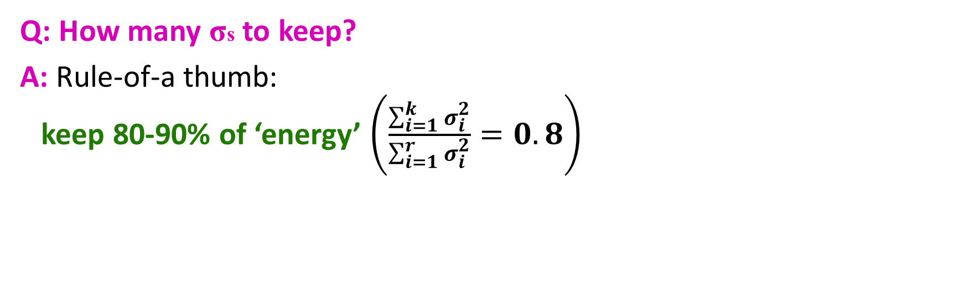
SVD – Dimensionality Reduction
Q: How many σs to keep?
A: Rule-of-a thumb: keep 80-90% of ‘energy’ $\left(\frac{\sum_{i=1}^{k}{σ_{i}^{2}}}{\sum_{i=1}^{r}{σ_{i}^{2}}}=0.8\right)$

Slide 24
SVD – Dimensionality Reduction
To compute SVD:
O(nm²) or O(n²m) (whichever is less)
But:
Less work, if we just want singular values
or if we want first k singular vectors
or if the matrix is sparse
Implemented in linear algebra packages like
LINPACK, Matlab, SPlus, Mathematica ...

Slide 25
SVD Case Study – How to Query?
Q: Find users that like ‘Matrix’
A: Map query into a ‘concept space’ – how?
Matrix
Alien
Serenity
Casablanca
Amelie
1 1 1 0 0
3 3 3 0 0
4 4 4 0 0
5 5 5 0 0
0 2 0 4 4
0 0 0 5 5
0 1 0 2 2
0.13 0.02 -0.01
0.41 0.07 -0.03
0.55 0.09 -0.04
0.68 0.11 -0.05
0.15 -0.59 0.65
0.07 -0.73 -0.67
0.07 -0.29 0.32
SciFi
12.4 0 0
0 9.5 0
0 0 1.3
=
x
x
Romnce
0.56 0.59 0.56 0.09 0.09
0.12 -0.02 0.12 -0.69 -0.69
0.40 -0.80 0.40 0.09 0.09

Slide 26
SVD Case Study – How to Query?
Q: Find users that like ‘Matrix’
A: Map query into a ‘concept space’ – how?
Matrix
Alien
Serenity
Casablanca
Amelie
Alien
q
q =
v2
v1
Project into concept space: Inner product with each ‘concept’ vector v_{i}
Matrix

Slide 27
SVD Case Study – How to Query?
Q: Find users that like ‘Matrix’
A: Map query into a ‘concept space’ – how?
Matrix
Alien
Serenity
Casablanca
Amelie
Alien
q
q =
v2
v1
q*v₁
Project into concept space: Inner product with each ‘concept’ vector v_{i}
Matrix

Slide 28
SVD Case Study – How to Query?
How would the user d that rated (‘Alien’,’Serenity’) be handled?
d_{concept} = d.V
Matrix
Alien
Serenity
Casablanca
Amelie
SciFi-concept
0.56 0.12
0.59 -0.02
0.56 0.12
0.09 -0.69
0.09 -0.69
x
=
5.2 0.4
q =
movie-to-concept
similarities (V)

Slide 29
SVD Case Study – How to Query?
Observation: User d that rated (‘Alien’, ‘Serenity’) will be similar to user q that rated (‘Matrix’), although d and q have zero ratings in common!
Matrix
Alien
Serenity
Casablanca
Amelie
SciFi-concept
d =
5.2 0.4
q =
2.8 0.6
Zero ratings in common
Similarity ≠ 0

Slide 30
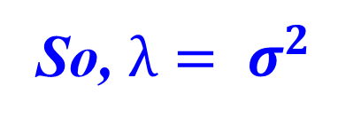
SVD – Relation to Eigen-decomposition
SVD gives us:
A = U Σ V^{T}
Eigen-decomposition:
A = X Λ X^{T}
A is symmetric
U, V, X are orthonormal (U^{T}U=I),
Λ, Σ are diagonal
Now let’s calculate:
AA^{T}= UΣ V^{T}(UΣ V^{T})^{T} = UΣ V^{T}(VΣ^{T}U^{T}) = UΣΣ^{T} U^{T}
A^{T}A = V Σ^{T} U^{T} (UΣ V^{T}) = V ΣΣ^{T} V^{T}
Shows how to compute SVD using eigenvalue decomposition!
X Λ² X^{T}
So, $λ= σ^{2}$
X Λ² X^{T}

Slide 31
SVD Drawbacks
Optimal low-rank approximation in terms of Frobenius norm
Interpretability problem:
A singular vector specifies a linear combination of all input columns or rows
Lack of sparsity:
Singular vectors are dense!
V^{T}
Σ
=
U

Slide 32
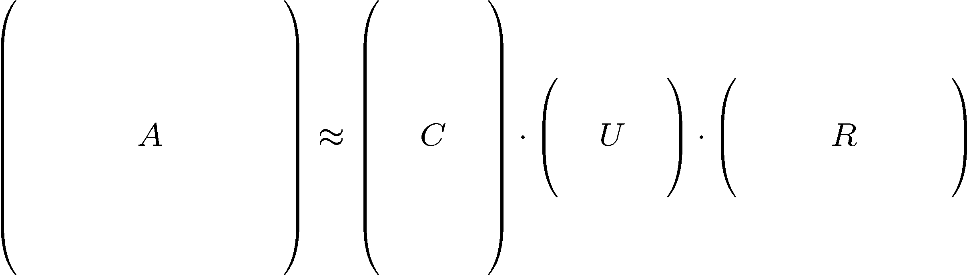
CUR Decomposition
Frobenius norm:
ǁXǁ_{F} = √ Σ_{ij} X_{ij}²
Goal: Express A as a product of matrices C,U,R
Make ǁA-C·U·Rǁ_{F} small
“Constraints” on C and R:
A
C
U
R

Slide 33
CUR Decomposition
Frobenius norm:
ǁXǁ_{F} = √ Σ_{ij} X_{ij}²
Goal: Express A as a product of matrices C,U,R
Make ǁA-C·U·Rǁ_{F} small
“Constraints” on C and R:
Pseudo-inverse of
the intersection of C and R
A
C
U
R

Slide 34
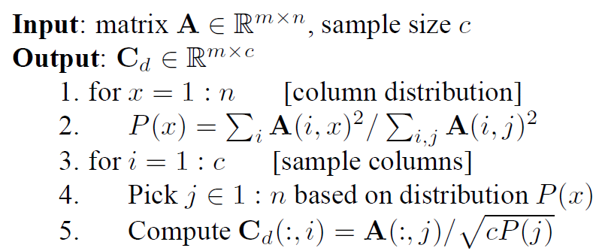
CUR: How it Works
Sampling columns (similarly for rows)
Note this is a randomized algorithm, same column can be sampled more than once

Slide 35
CUR: Computing U
Let W be the “intersection” of sampled columns C and rows R
Let SVD of W = X Z Y^{T}
Then: U = W⁺ = Y Z⁺ X^{T}
Ζ⁺: reciprocals of non-zero singular values: Ζ⁺_{ii} =1/ Ζ_{ii}
W⁺ is the “pseudoinverse”
A
C
R
W
≈
U = W⁺

Slide 36
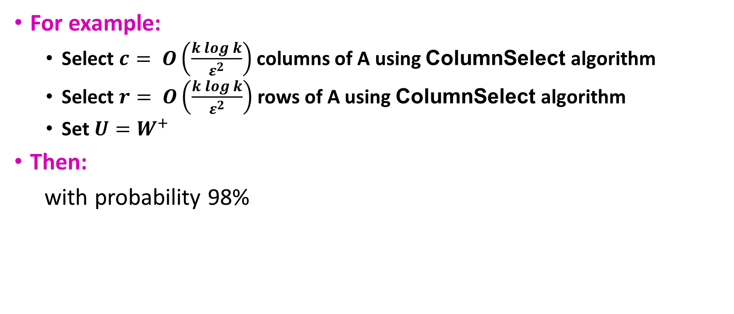
CUR: Provably good apprx. To SVD
For example:
Select $c= O\left(\frac{k\log{k}}{ε^{2}}\right)$ columns of A using ColumnSelect algorithm
Select $r= O\left(\frac{k\log{k}}{ε^{2}}\right)$ rows of A using ColumnSelect algorithm
Set $U=W^{+}$
Then:
with probability 98%
CUR error
SVD error

Slide 37
CUR Pros and Cons
Easy interpretation
Since the basis vectors are actual columns and rows
Sparse basis
Since the basis vectors are actual columns and rows
Duplicate columns and rows
Columns of large norms will be sampled many times
Actual column
Singular vector

Slide 38
Solution
If we want to get rid of the duplicates:
Throw them away
Scale (multiply) the columns/rows by the square root of the number of duplicates
A
C_{d}
R_{d}
C_{s}
R_{s}
Construct a small U

Slide 39
SVD Vs. CUR
sparse and small
SVD: A = U Σ V^{T}
Huge but sparse
Big and dense
dense but small
CUR: A = C U R
Huge but sparse
Big but sparse

Slide 40
SVD Vs. CUR
SVD
SVD
CUR
CUR no duplicates
CUR
Accuracy:
1 – relative sum squared errors
Space ratio:
#output matrix entries / #input matrix entries
CPU time

Slide 41

Questions???

Slide 42
Acknowledgements
Most of this lecture slides are obtained from the Mining Massive Datasets course: http://www.mmds.org/

